Slide 1
Empowering Healthy Aging
An Exploration of Evidence-Based Community Health Programs in NC

Slide 2
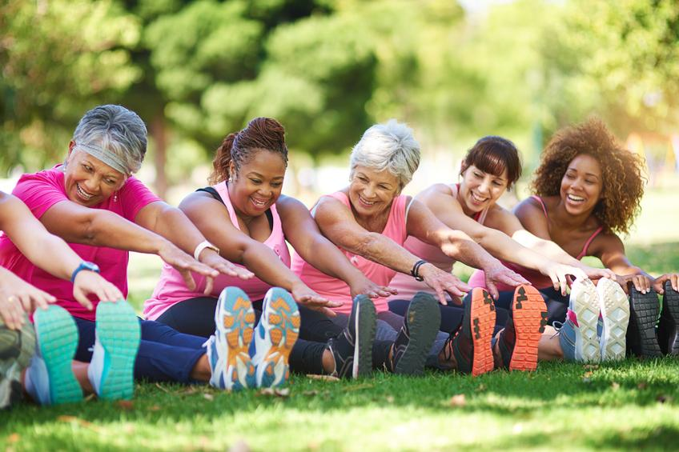
Healthy Aging NC
Healthy Aging NC is North Carolina’s statewide resource center for evidence-based health promotion programs.
Our Services…
Connect people to the programs and agencies that improve community health
Increase the capacity of providers to deliver these programs
Maintain a website with program information and online registration options
Collect and analyze data to report results statewide

Slide 3
Goals of Healthy Aging NC
Improve Quality of Life & Independence
Address Economic Impact/reducing healthcare costs associated with age-related issues
Support Healthcare System Sustainability/alleviate health system pressures by reducing burden
Advance Social Cohesion/community engagement/belonging
Notes:
Amber

Slide 4
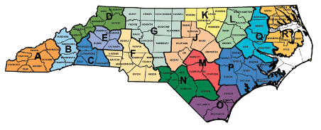
Healthy Aging NC Partnerships
NC’s 16 Regional Area Agencies on Aging
Community-Based Organizations: YMCAs, Recreation & Parks Departments, Senior Centers, Libraries, State extensions
Faith-based organizations
Clinical Providers: Hospital systems, Physical Therapists, AHECs

Slide 5
Healthy Aging NC is funded through the following grants:
CDC State Public Health Approaches to Addressing Arthritis
ACL Falls Prevention Grant
ACL Innovations in Nutrition
ACL CDSME III PEARLS
DPH Falls Prevention Awareness (Injury & Violence Prevention)
Division of Aging - Social Isolation & Social Bridging Project

Slide 6
CDC Arthritis & Wellbeing Program
Healthy Aging NC is funded in part by a 5 year Centers for Disease Control and Prevention Grant (2023 - 2028)
The purpose of this project is to improve wellbeing for adults across North Carolina.

Slide 7
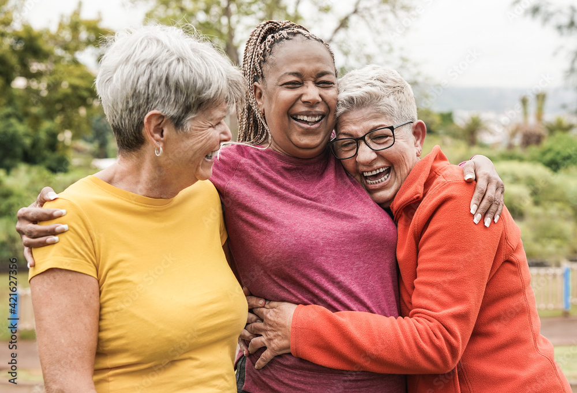
Key Strategy of
the CDC Grant:
Sustainably disseminate and increase the availability of and participation in recommended and promising evidenced-based programs, with an emphasis on physical activity promotion

Slide 8
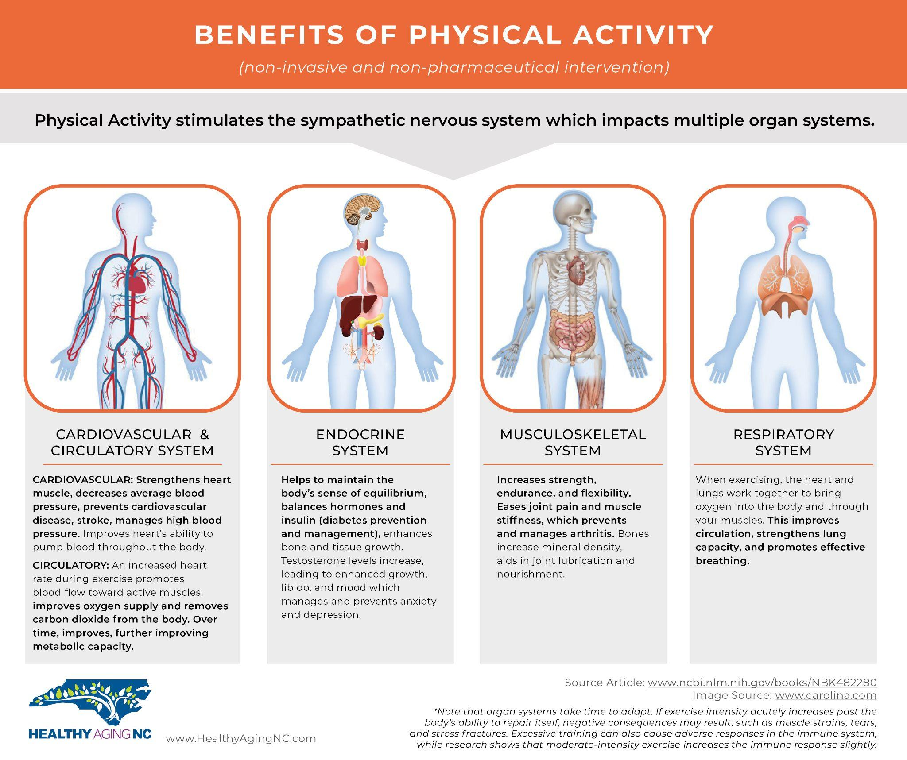
Notes:
Nadia review this information, invites discussion

Slide 9
What are evidence-based programs?
Evidence-based programs (EBPs) offer proven ways to promote health and prevent disease among adults.
They are based on research and provide documented health benefits.
Many EBPs allow for more efficient use of available community and health care resources as they use trained lay leaders and/or coaches

Slide 10
Immediate benefits of evidence-based programs
These programs address specific problems and goals for people with ongoing health problems.
Participants choose their own goals and track their own progress toward success.
Support and social interaction with peers who are living with ongoing health conditions
Trained peer leaders offer guidance and support/participants find practical solutions individually and together.
Notes:
Amber

Slide 11
Programs Supported by our CDC Grant:
Walk with Ease/Camine Con Gusto
Purpose: Help participants safely build and maintain a walking routine
Training: ~2-3hr self-paced online training (+ CPR certification)
Leading: 6 weeks, 1-3 sessions/week, up to 1 hr/session
https://oaaction.unc.edu/aaebi/
https://oaaction.unc.edu/aaebi/
Notes:
https://oaaction.unc.edu/aaebi/

Slide 12
Walk with Ease Delivery Formats

Slide 13
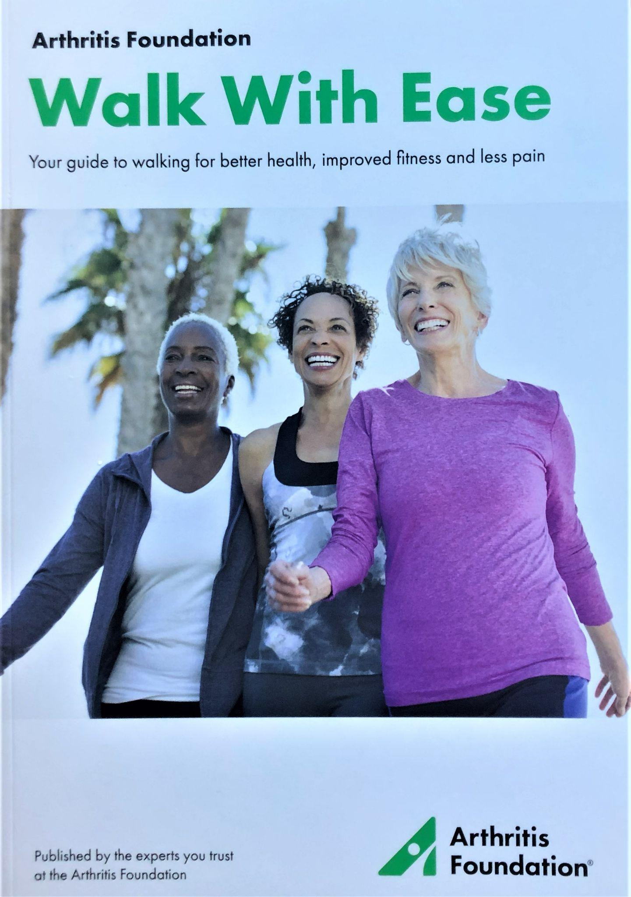
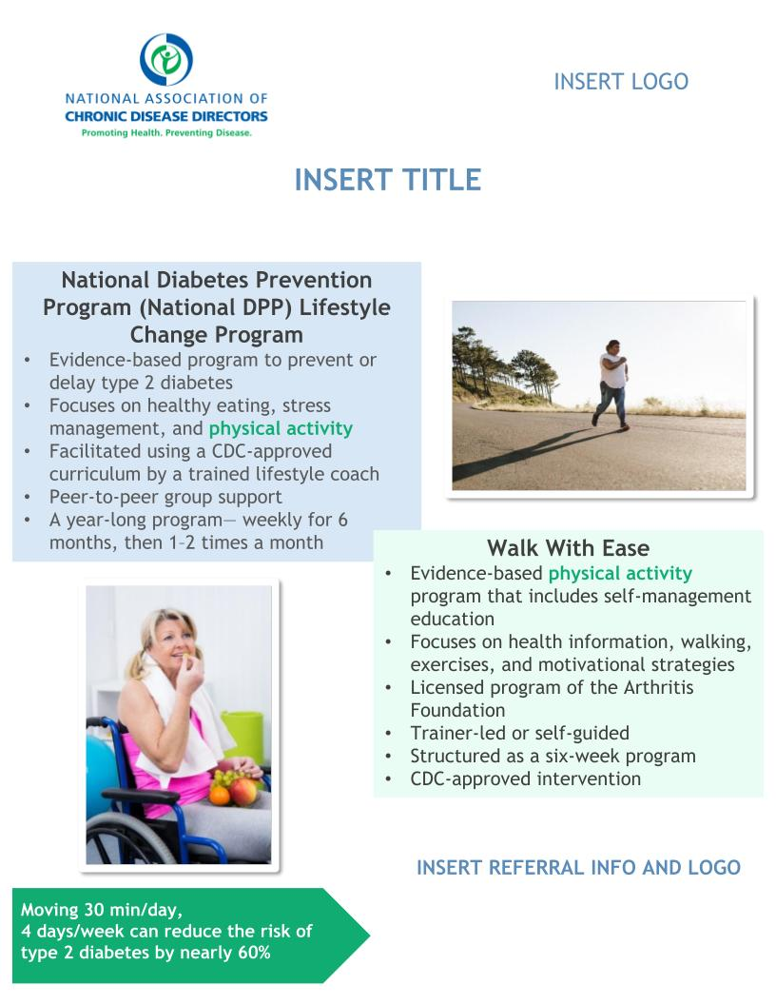
More on Walk with Ease!
Self-Directed Walk With Ease &
Camine Con Gusto
Great for coupling with the Diabetes Prevention Program!
https://oaaction.unc.edu/aaebi/
https://oaaction.unc.edu/aaebi/
Notes:
https://oaaction.unc.edu/aaebi/

Slide 14
Self-Directed WWE Week 1 Video
Video from extension agent in Delaware offering Walk with Ease in her community!
Shares more information about the WWE program
Reviews some tips from the WWE guidebook
Reiterates the benefits of physical activity

Slide 15
“Living Healthy” with Chronic Disease Self-Management Education
Chronic Disease Self-Management Program (CDSMP)
Chronic Pain Self-Management Program (CPSMP)
Diabetes Self-Management Program (DSMP)
Tomando Control De Su Salud

Slide 16
More on Living Healthy Programs!
Chronic Disease/Pain Self-Management Program (& Tomando Control de Su Salud) + toolkits
Purpose: Provide education/tools to help participants better manage chronic conditions
Training: 4-day in-person training or online training [7 weeks, 13 zoom sessions (1-2/week), 2.5-hours/session]
Leading: 6 weeks, 1 session/week, 2.5 hours/session
Video from New York, sharing more about the benefits
https://oaaction.unc.edu/aaebi/
https://oaaction.unc.edu/aaebi/
Notes:
https://oaaction.unc.edu/aaebi/

Slide 17
Programs Supported by our CDC Grant:
Tai Chi for Arthritis and Fall Prevention
Purpose: Improve movement, decrease falls, and connect peers
Training: ~15hr in-person 2-day or online/hybrid training + CPR
Leading: 2x/week for 8 weeks (or 1x/week for 16 weeks)
Video - let’s practice together!
https://oaaction.unc.edu/aaebi/
https://oaaction.unc.edu/aaebi/
Notes:
https://oaaction.unc.edu/aaebi/

Slide 18
Programs Supported by our CDC Grant:
EnhanceFitness
Purpose: Become more active, energized, and empowered
Training: 12- hour in-person or remote training
Leading: 1 hour/session, 3x/week (ongoing), check-in every 4 months
Video from UW, highlighting the benefits of EnhanceFitness & staying active as we age
https://oaaction.unc.edu/aaebi/
https://oaaction.unc.edu/aaebi/
Notes:
https://oaaction.unc.edu/aaebi/

Slide 19
Programs Supported by our CDC Grant:
Program for Encouraging Active and Rewarding Lives (PEARLS)
Purpose: Reduce symptoms of depression and improve quality of life
Training: 8 hours of online modules, a live practice session, and a training evaluation
Leading: Six to eight in-home (or virtual) counseling sessions
Video from our partners at Centralina in Charlotte, NC!
https://oaaction.unc.edu/aaebi/
https://oaaction.unc.edu/aaebi/
Notes:
https://oaaction.unc.edu/aaebi/

Slide 20
Continuum of Care Approach
EnhanceFitness
PEARLS & Health Coaching

Slide 21
Ways to get involved
Explore programs on our website
Refer participants to programs as appropriate
Sign Up for Self-Directed Walk with Ease
Become a Leader of an evidence-based program
Check out our Health Coach Network & Healthcare Provider Engagement Pages
Reach out to me with your thoughts and questions!
Notes:
Nadia: 29 - 30
Become a leader
involvement could be different in every county,

Slide 22
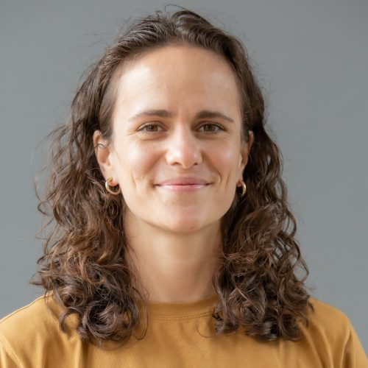
Thank you!
Nadia Z. Mazza, MPH, is the CDC Project Director for the Healthy Aging NC initiative with the NC Center for Health and Wellness at UNC Asheville.
Email Nadia at nmazza@unca.edu to learn more about this and other opportunities to partner with Healthy Aging NC!

