Slide 1
The Puzzle: How does ECA fit?

Slide 2
ECA
For more than one hundred years, ECA members have been leaders in their communities by identifying needs and rallying the people and resources to meet those needs.
The purpose of ECA is to empower individuals and families to improve their quality of living through continuing education, leadership development and community service.

Slide 3
ECA:
Local Clubs
County ECA Council
District ECA Council
NCECA State Council

Slide 4
Local Clubs
ECA began in 1913 as neighborhood or community clubs where members volunteer their time, skills and energy to strengthen communities.
Organized: geographically, by interest or are project driven
Meet on their own schedule
Each club pays club dues

Slide 5
County Council
Local clubs come together to form a County Council
Many counties no longer have local clubs so all ECA members meet regularly as a County Council
The purpose is to plan programs
and projects to assist NCCE in
meeting the needs of the county.

Slide 6
District Council
All counties in a district comprise the District ECA Council and meet at least annually for District Day to:
celebrate accomplishments
execute Cultural Arts competition
provide educational opportunities
They are encouraged to meet more often as a whole or in clusters for educational training.

Slide 7
NCECA Leadership Team
The Leadership Team consists of President, President-elect, Past President and the VP of each District
Purpose:
Transact business between State Council
Develop policies subject to approval of State Council
Develop the educational program

Slide 8
State Council
State Council is all of Leadership Team, all county presidents, all past NCCECA presidents and any member serving as national officer
Purpose:
Have final approval of plans to achieve the mission and purpose of NCECA
Meet annually at State Conference

Slide 9
Recognizing Achievements
Annual Reports
Individual
Club
County
Outstanding Volunteer
Certified Volunteer Unite – CVU
Service Longevity
25 years and every 5 years thereafter
Leadership Award
Notes:
Individual reports capture all volunteer work and contributions These are used to compile a club report.
Clubs combine all individual reports to send to the county.
All club reports are compiled into a county report
Counties compile a total of all club reports and submits to NCECA. At State Conference, counties are awarded gold, silver and bronze awards that reflect the number of hours reported divided by the number of members in the county.
One volunteer from each county will be recognized for outstanding service to ECA.
CVU is an individual report of volunteer hours reported. Members achieving 500 volunteer hours of service will be recognized. Additional hours are carried over and recognition occurs at 500 hour intervals.
Service Longevity recognizes the years of membership, starting with 25 years and then every 5 years after.
The Leadership Award is awarded through filing the Leadership Candidate Application. One from each county progresses to the District and one from each district is recognized at State Conference.

Slide 10
ECA in 2017
2000 members
from only 60 counties reported:
318,874 volunteer hours
@ $23.07/hour
The gift to fellow North Carolinians $7,697,618.36
Notes:
This is the Annual Report numbers. ECA in about 72 counties. Reports . . . .

Slide 11
There is power in numbers because people working together are stronger than they can ever be working apart.
That’s why ECA:
builds strong partnerships with other civic organizations and Cooperative Extension
values relationships above all else, and
believes in the incredible potential of human connection.
Notes:
During this conference you will hear about three exciting opportunities where we have formed partnerships with other organizations. That is the charge to the LT and Geri . . . To look for ways for ECA to partner with others to strength our communities. There is power in numbers!!

Slide 12
What is NVON?
Notes:
NCECA as an organization belongs to NVON. Lets look at what NVON is . . .

Slide 13
“Member organizations working together to promote communication,
education and volunteerism
for all people"

Slide 14
Eight States:
*Arkansas *Illinois
*Indiana *Kentucky
*North Carolina *South Carolina
*West Virginia *Wisconsin
Notes:
NC is the newest member of this group. In 1995, seven states withdrew from National EHA to form NVON. NC joined in 2006.

Slide 15
works with Country Women’s Council (CWC) and Associated Country Women of the World (ACWW)
promotes friendship and understanding in the world
promotes sharing between member states
promotes well-being of individuals and families
brings about a better understanding of the relationship of home, community, state, nation and the world
speaks for and further interests of member organizations engaged in service to families and communities
coordinates activities and disseminates information relevant to the Associated Country Women of the World (ACWW) and Country Women's Council USA (CWC)
distributes Land Grant College and University research based educational information
Notes:
What does NVON do?
Do you recognize any of this verbiage? Falls in line with ECA’s mission . . .

Slide 16
Project in Common
Member states work together on a Project in Common that rotates between international, national, and membership.
The Project in Common for 2013-2015 was “Water Around The World.” Contributing more than $96,500, NVON impacted lives worldwide, one filter at a time in places as Haiti, Zimbabwe, Mozambique, Thailand, Sierra Leone and Nepal.
For 2016 – 2018, our Project in Common was Eat Local, Eat Healthy. This project emphasized the local foods movement.
2019 – 2021, the Project in Common is Double Your Influence: Add 2. Volunteering in the U.S. is at a 10-year low. Nonprofits need to start taking volunteer retention seriously.
Notes:
Each of the 8 states work closely with the Extension Service in their state. While all states work on similar projects and programs, many will engage in other programs and projects that meet the needs in their state. This diversity if welcomed and we do share programs . . . Visit NVON.org and listed there is a link to each member state. On those websites, you can find programs from the other states. The one commonality required is that all states work together on a given project.

Slide 17
NVON Project in Common
#1 – Keep volunteer retention in mind from the start.
#2 – Track your organization’s volunteering data.
#3 – Provide volunteers with the resources they need.
#4 – Leverage volunteer skills and strengths.
#5 -Follow-up and stay in touch.
#7 – Thank, thank, and thank again.
http://www.nvon.org/membership/

Slide 18
ECA is part of a national puzzle . . .
There is power in numbers and in conversations – the ability to acknowledge where the problems lie and the power to change life trajectories.
Notes:
Now we begin to see how ECA can impact families nationwide.

Slide 19
Country Women’s Council USA
The Country Women’s Council of the United States of America (CWC), is a coordinating council, composed of Associated Country Women of the World (ACWW) member societies in the USA and meets annually to promote the work of ACWW.
Notes:
Member societies that are in the US and belong to ACWW are part of the coordinating council called CWC

Slide 20
Member Societies
National Master Farm Homemaker’s Guild
NVON states
Other support groups for Cooperative Extension in other states, i.e Family & Community Education, Homemakers, etc.
Notes:
By being a member of NVON, ECA becomes a member of CWC.

Slide 21
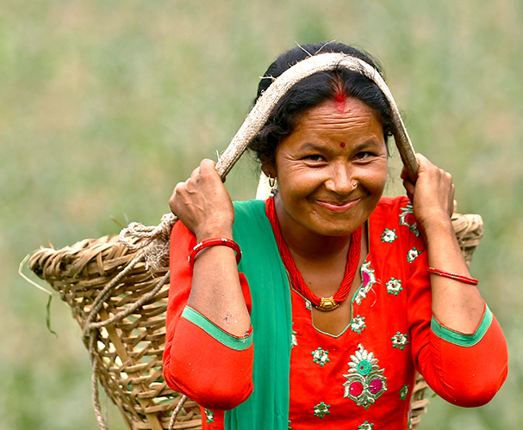
Projects & Events
Zero Hunger challenge - The Zero Hunger vision reflects five
elements from within the Sustainable Development Goals, which taken
together, can end hunger, eliminate all form of malnutrition, and build
inclusive and sustainable food systems.
Enhancement of Nutritional Health Security through Home Gardens for Dalit Women (Fully Funded) - The beneficiaries of this project will be 250 Dalit women and their families (around 2,150 people in total) who are in 25 deprived rural villages in Thanjavur district, Tamil Nadu.
Women Walk the World for ACWW - April 29
Your participation in Women Walk the World will help ACWW achieve its goal of connecting and supporting women worldwide. Women Walk the World is an ongoing fundraiser for Pennies for Friendship and Celebration of ACWW Day. It has become a successful event worldwide.
International Day of Rural Women - October 15
The crucial role that women and girls play in
ensuring the sustainability of rural households
and communities, improving rural livelihoods and
overall wellbeing, has been increasingly
recognized.
Notes:
Enhancement of Nutritional Health Security through Home Gardens for Dalit Women (India) The beneficiaries of this project will be 250 Dalit women and their families (around 2,150 people in total) who are in 25 deprived rural villages. These beneficiaries will be trained in nutrition education, breastfeeding promotion, food safety, home gardening and sustainable cooking methods
Women Walk the World for ACWW - April 29 Your participation in Women Walk the World will help ACWW achieve its goal of connecting and supporting women worldwide. Women Walk the World is an ongoing fundraiser for Pennies for Friendship and Celebration of ACWW Day. It has become a successful event worldwide.
International Day of Rural Women - October 15 The crucial role that women and girls play in ensuring the sustainability of rural households and communities, improving rural livelihoods and overall wellbeing, has been increasingly recognized.

Slide 22
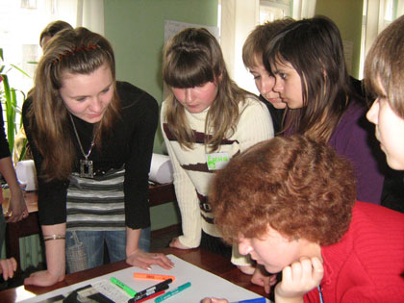
Notes:
By being a member of NVON, ECA becomes a member of ACWW. So what is ACWW?

Slide 23
What is ACWW?
One of the largest international organisations for women’s groups
ACWW has over 460 Member Societies worldwide in over 70 countries
ACWW was established in Geneva in 1927
ACWW has a Board of Trustees and six Specified Committees: Agriculture, Finance, UN, Projects, Triennial Conference and Communications and Marketing.

Slide 24
ACWW’s Vision and Mission
Vision: An improved quality of life for women and communities worldwide.
Mission: The ACWW membership and networks of rural and non-rural women will empower women and communities worldwide through: partnership, advocacy, sharing of knowledge and local activities.
Notes:
A vision and mission of an organisation can be defined as the following:
Vision: what the organisation wants to be, or how it wants the world in which it operates to be (an "idealised" view of the world).
Mission: the purpose of the organisation -describing why it exists and what it does to achieve its vision
With this in mind, ACWW’s vision and mission are the following:
Vision: An improved quality of life for women and communities worldwide.
Mission: The ACWW membership and networks of rural and non-rural women will empower women and communities worldwide through: partnership, advocacy, sharing of knowledge and local activities.
AIMS AND OBJECTIVES
The following are ACWW’s Aims and Objectives according to its Constitution:
TO RAISE the standard of living of rural women and families through education, training and community development programs.
TO PROVIDE practical support to its members and help them set up income-generating schemes.
TO SUPPORT educational opportunities for women and girls and the elimination of gender-based discrimination
TO GIVE rural women a voice at international level through its links with UN agencies.

Slide 26
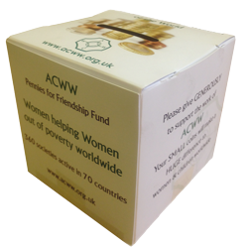
How ACWW is Financed
Pennies For Friendship is the lifeblood of ACWW and enables the production of awareness raising materials.
Dues are payable per annum by Member Societies & Individual Members
Donations, Legacies and Grants are welcome through the Women Empowered Fund
ACWW receives no government funding
Notes:
ACWW Funds
Pennies for Friendship – General Fund set up at the beginning of ACWW’s life to sustain the running of the organisation
Membership Categories
Societies
Category I – voting £95 an association with minimum of 500 members
Category II – voting £58 an association with minimum of 100 members
Category III – voting £48 umbrella or national organisation
Category IVA - non-voting £32 a group interested in the work of ACWW
Individual members
Category IVB - non-voting £20 for 1 year
£50 for 3 years

Slide 27
How is ACWW Financed?
ACWW is completely reliant on public support - without this, we could not deliver our development programs, give women a voice at the UN and other international levels, or continue facilitating women-to-women empowerment and engagement.
Nutrition,
Good Health & Wellbeing
Sustainable Agriculture Training & development
Education & Capacity Building
The Women Empowered Fund was launched in 2018 as ACWW’s new funding initiative for projects. By supporting one of the six Focus Areas, a difference is made to communities around the world.
Income Generation
& Livelihood
Sustainable Water. Sanitation & Energy
Maternal & Reproductive Health

Slide 28
ACWW Projects
ACWW and Member Societies have together funded more than 950 projects.
ACWW actively supports a range of development programs in communities around the world:
Education & Capacity Building
Nutrition, Good Health & Wellbeing
Sustainable Agriculture Training & Development
Income Generation & Livelihood
Sustainable Water, Sanitation & Energy
Maternal & Reproductive Health

Slide 29
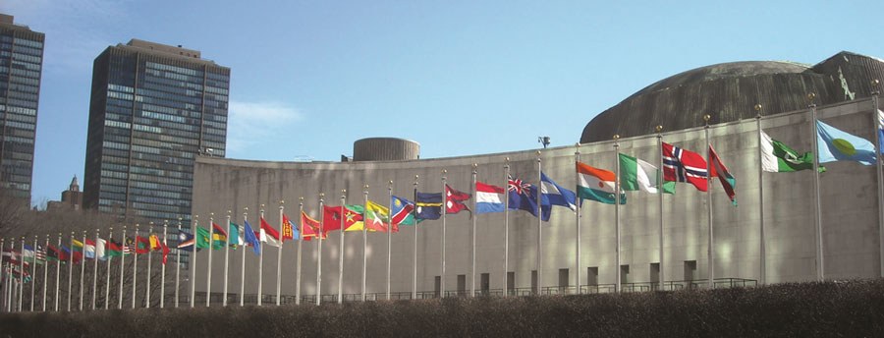
ACWW and the United Nations
Consults UN agencies e.g. Economic and Social Council (ECOSOC)
ACWW UN representatives in New York, Geneva, Rome, Vienna, & Bangkok
ACWW speaks for women at UN meetings & updates UN about its activities
ACWW informs its members about UN developments, helping them to identify areas where they can participate in UN activities
Notes:
Bullet Point 1:
ACWW’s consultative status with agencies like ECOSOC, the Food and Agriculture Organization (FAO) and UNESCO allows it to participate in meetings and consultations. ACWW has had official relations with the UN almost since the beginning of the UN, well before the huge increase in the number of NGOs (Non-Governmental Organisations) in the world.
Bullet Point 2:
New York is the headquarters of the UN. Geneva hosts important UN agencies like the human rights office and the World Health Organization. Rome is home to the food-based organisations: FAO, the World Food Programme and the International Fund for Agricultural Development. Vienna is where the UN Office on Drugs and Crime meets, along with NGO groups relevant to ACWW like the NGO Committee on the Family. Bangkok houses the UN Economic and Social Commission for Asia and the Pacific.
Bullet Points 3 & 4:
ACWW members can help strengthen this communication with the UN. Are there particular issues you think should be raised with the Commission on the Status of Women or other UN agencies? Let the UN Committee know. Would you like to participate in future UN events? Consider becoming a Friend of the UN Committee.

Slide 30
ACWW and the UN
www.un.org/sustainabledevelopment/takeaction/
Notes:
In 2015, more than 190 world leaders committed to 17 Sustainable Development Goals (SDGs) to help us all end extreme poverty, fight inequality & injustice, and fix climate change. We each have a role to play if we’re going to achieve these goals of a more prosperous, equitable, and sustainable world.
For the goals to be reached, everyone needs to do their part: governments, the private sector, civil society and people like you.
Do you want to get involved? You can start by telling everyone about them. We’ve also put together a list of actions that you can take in your everyday life to contribute to a sustainable future. Go www.un.org/sustainabledevelopment/takeaction for “lazy person’s guide to saving the world”!

Slide 31
There is power in numbers and there is power in unity.”
Dr. Martin Luther King, Jr.
Never underestimate the difference YOU can make in the lives of others.
Step forward, reach out and help.
Do more than belong: participate.
Do more than care: help.
Do more than believe: practice.
Do more than be fair: be kind.
Do more than forgive: forget
Do more than dream: work.
ECA: Making a difference
locally, nationally and internationally

Slide 32
Resources
NCECA – go.ncsu.edu/nceca
NVON – nvon.org
CWC – cwcusa.org
ACWW - acww.org.uk
United Nations – unausa.org

